Slide 1
Data Validation for Data Science PyData London June 2022 Tutorial https://github.com/NatanMish/data_validation
Natan Mish
Machine Learning Engineer

Slide 2
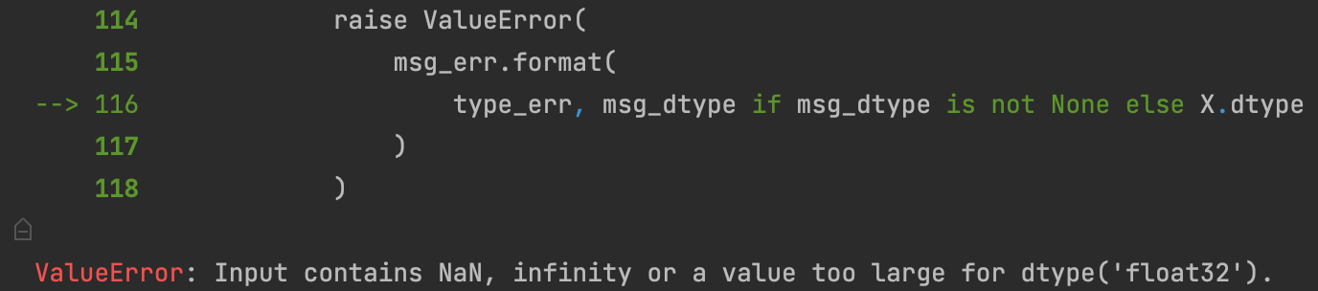

Looks familiar?

Slide 3
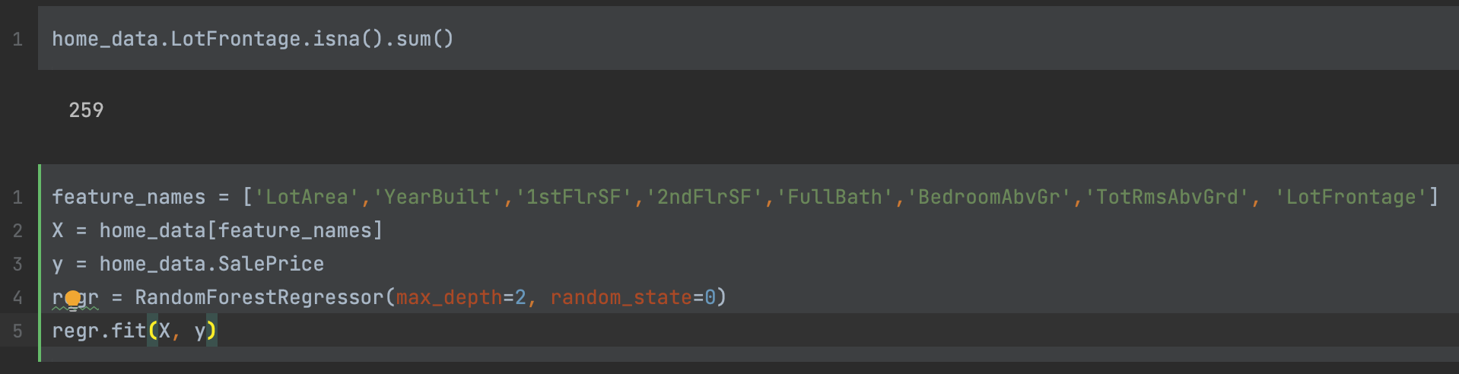

Slide 4
About me
Machine Learning Engineer @ Zimmer Biomet
Up until a year ago Data Scientist @ Zeelo
MSc in Social Data Science from the London School of Economics
Previously worked in the finance and fintech industries
Also…
I like finding bugs

Slide 5
Agenda
Who needs data validation anyway?
Validation in training pipelines using Pandera
Validation in databases using Great Expectations
Validation in model serving using Pydantic
Other tools and concepts

Slide 6
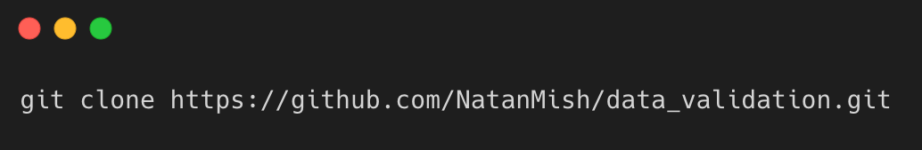

Tutorial Instructions
Alternatively, click the ”Open in Colab” link straight from the notebook on GitHub.
Environment requirements: Python 3.7 and up with Jupyter installed.
Clone the repository from GitHub using the CLI:
Follow the instructions in the notebook

Slide 7
What does Data Validation mean?
Data validation is the practice of checking the integrity, accuracy and structure of data before it is used.
Useful in any kind of work that uses data – software development, research, accounting, military intelligence.
We can validate types, ranges, consistency and incorporate business logic.

Slide 8
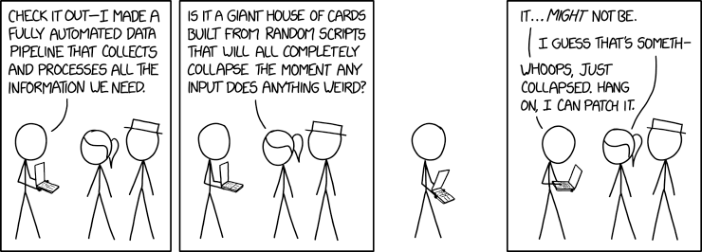
Why validate your data?

Slide 9
Maintain Data Integrity
Ensure system stability.
Ensure system reliability.
Align with the rest of the architecture by comparing downstream and upstream schemas.

